Slide 1
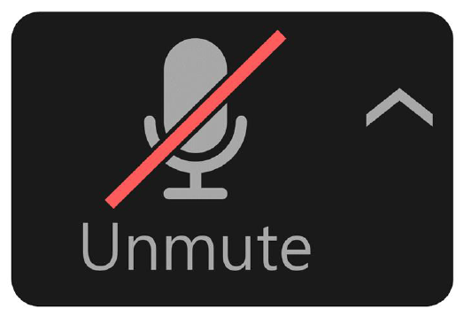


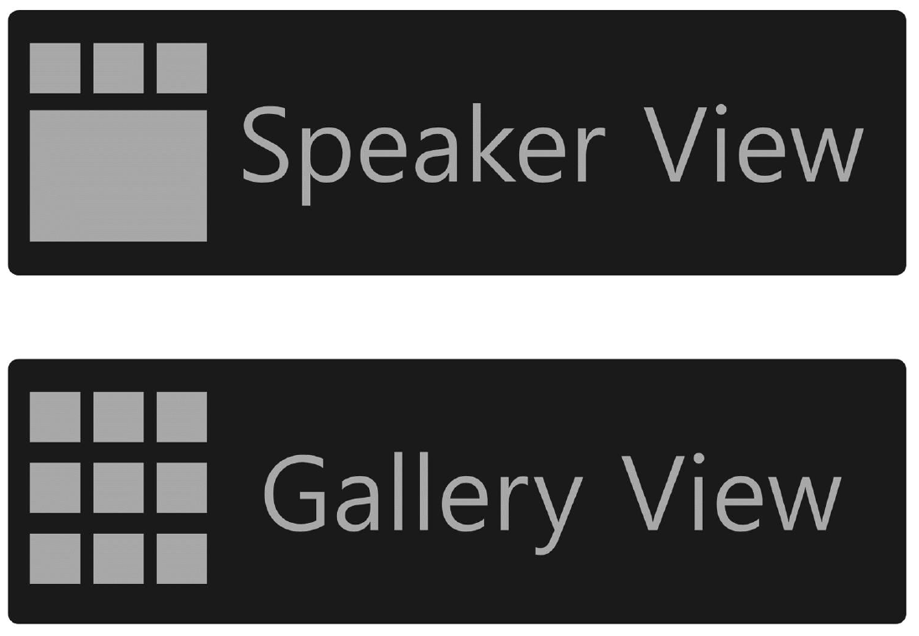
Zoom Tips
Everyone in the meeting is muted. Please remain muted unless you are in a breakout session or asked to share out.
Presenters love seeing their audience, so if you're comfortable, turn your camera on so they can see you nodding in understanding and encouragement. If you want to make sure to look your best, face a window or light source.
The chat box is a good place to engage with other participants and ask questions. Selecting this icon will open the chat window.
Speaker/Gallery View
Speaker view shows the active speaker. Gallery shows all participants. Make sure to take the time to find that button (at the top right corner of your screen) so you can switch between the views.

Slide 2
Science Standards for Alaska (SSAs)
Bjørn Wolter, Ph.D. & Deb Riddle
Alaska Department of Education & Early Development
January 27, 2021
Notes:
Every DEED presentation should start with this title slide. Adjust presenter(s) names as appropriate.

Slide 3


Our Mission and Vision

Slide 4


DEED
DEED exists to provide information, resources, and leadership to support an excellent education for every student every day.
Notes:
We exist to be a resource for you!

Slide 5

Alaska’s Education Challenge
Notes:
We are guided by the 3 pillars of the Education challenge

Slide 6

Agenda
Introductions
Why new standards?
The Standards
How to read the SSAs
Major shifts
Learning strategies
Resources
Upcoming webinars
Notes:
We are going to do a quick introduction activity; review the reasoning behind the new standards; look at how to read the standards; investigate some major shifts in the document; and then take a look at some strategies for instruction. Finally, we will wrap up with a review of some resources and look at the other upcoming webinars.

Slide 7
Introductions
Notes:
Zoom renaming activity—First name, district, grades
1:00

Slide 8
Why did the state need new standards?
Notes:
0:15

Slide 9


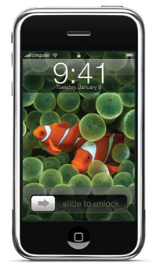
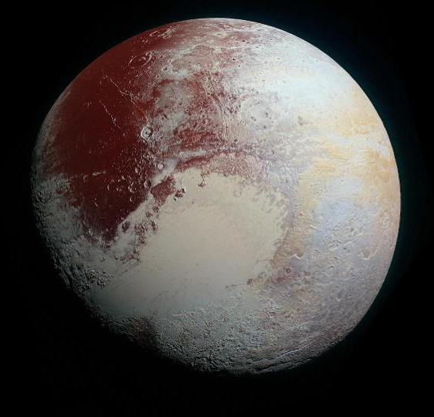
Why New Standards?
Notes:
The last revision of the science standards was in 2005, published in early 2006. Those were the Grade Level Expectations, or GLEs. And to be completely honest the GLEs were just plain out of date. An awful lot has transpired since the early 2000’s that significantly impacts science education, including major socio‐cultural changes and technological advances.
I would like to challenge you to consider some changes in science and technology over the past fifteen years that have significantly impacted your or your community. Go ahead and share in the chat box…
Since that time, Pluto has been both reclassified as a dwarf planet and visited by the New Horizons probe, the Higgs Boson was discovered at CERN, the CRISPR‐Cas9 system has dramatically altered our ability to precisely edit DNA, several new hominin and ancestral human species have been identified, we have confirmed Einstein's theory that gravitational waves impact space‐time, the first human‐made objects have left our Solar System (Voyagers 1 & 2), and the first iPhone was released [phones now run our lives].
1:30

Slide 10
Need for New Standards?
STEM Jobs
Need
Interest
Notes:
Another reason we needed new standards is that while the number of jobs in Science, Technology, Engineering, and Mathematics (STEM) is growing, student interest in these fields is declining.
Students are not choosing science:
According to a national survey of more than a million students who took the ACT test, nearly 90% of high school graduates say they are not interested in a career or a college major involving any of the STEM fields. This probably still has a lot to do with socio‐cultural perceptions of scientists, engineers and mathematicians as old white dudes with a beard, glasses, and a lab coat. (I would like to point out that I am NOT wearing a lab coat and even though I am not THAT old...) There are also unfortunately persisting and entrenched ideas about who can “be” any of these (i.e. you have to be “super smart”). And although children’s perceptions are changing, we still have a long way to go.
The number of students who want to pursue engineering or computer science jobs is actually falling precipitously, at just the moment when the need for those workers is soaring.
Obviously we need to do a better job of making science relevant and engaging for students.
1:30

Slide 11
Development Process
Dec. 2018
Writing Committee
Review Committee
Writing Committee
Review Committee
Writing Committee
Feb. 2018
Adoption
State Board
Public Comment
June 2019
Notes:
The development process for new science standards started in earnest in 2017. DEED established a rigorous writing and review cycle to ensure the standards developed met our state needs while keeping Alaska competitive at the national level. DEED recruited K‐12 and postsecondary faculty to participate in both the Writing and Review Committees.
The Writing Committee was comprised of 15 Alaskan educators broken into three grade span groups (elementary, middle school, and high school). The Science Standards Writing Committee was responsible for “writing” the science content standards. Writing Committee members had a deep understanding of science instruction and assessment, science content and skills, and applications of science knowledge and skills. The Writing Committee, to the extent practicable, represented the diversity of Alaska’s educational settings and communities, and DEED worked hard to ensure both rural and urban educators had a voice in creating the new standards.
Writing Committee members worked both individually and as a group to accomplish the following tasks:
Identify and review influential sets of science content standards.
Identify, modify, write, and compile a recommended set of science content standards drawing on its members’ expertise and review of relevant materials.
Following peer review, make appropriate changes.
The Review Committee was comprised of 27 Alaskan science educators representing more than 300 combined years of teaching experience. The Science Standards Review Committee was responsible for reviewing and providing detailed feedback on the content standards recommended by the Writing Committee. Review Committee members also all had a deep understanding of science instruction, assessment, content, and application. Again, DEED worked hard to ensure that Review Committee members were representative of the educational diversity in our state. The Review Committee worked individually to review drafts of the recommended science standards, and provide written feedback, including suggested changes in wording, to the Writing Committee.
2:00

Slide 12


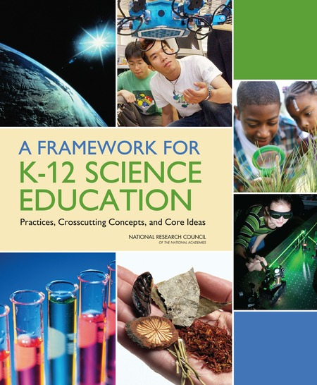




What standards were considered as examples?
Notes:
DEED and our contractor, the Center for Assessment, asked WC members to consider multiple sources when developing the new standards. These included national documents like:
The Framework for K-12 Science Education
The Next Generation Science Standards
Standards for the NAEP assessment
Past science standards such as AAAS’ Project 2061
The committee also considered science standards from other leading states, including: Washington, California, Nevada, Georgia, and Kentucky; International standards like for the PISA and TIMSS assessments; And finally, standards from affiliated organizations such as the College Board and ACT.
0:45

Slide 13
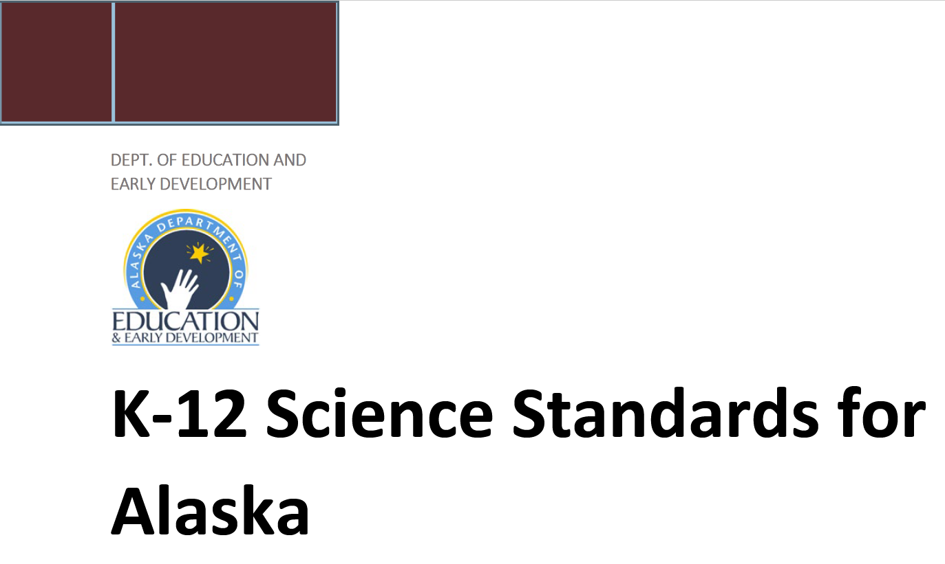
K-12 Framework
Notes:
Many of you may be familiar with both the Framework for K-12 Science Education and the Next Generation Science Standards (NGSS), and I would like to take a moment to define the relationship between these two documents and the SSAs.
The Framework is not a standards document. It was released in 2011 and provides a sound, evidence-based foundation for standards by drawing on current scientific research—including research on the ways students learn science effectively—and identifies the science all K–12 students should know. It provides the foundation on which both the NGSS and SSAs are built.
The NGSS are state standards. They were publicly released in April 2013. They were developed in cooperation between Achieve and a number of core states. The SSAs are Alaska state standards. We released them in June 2019. It is important to note that while there are many similarities between the Science Standards for Alaska and the Next Generation Science Standards (NGSS), and both are based on the Framework, they are NOT the same document.
1:00

Slide 14
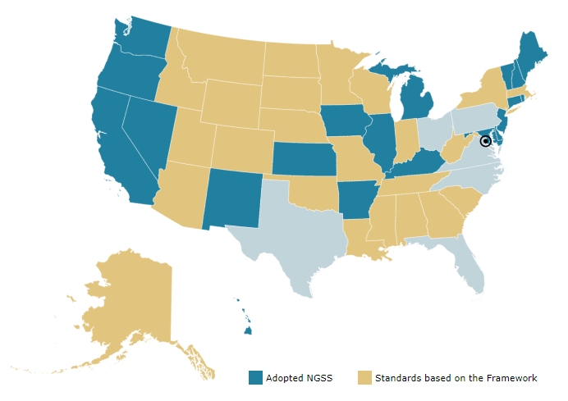
Map of USA
Notes:
It is important also to note that the SSAs are not a curriculum. They are standards. Your district will need to either develop a science curriculum or purchase an existing one that aligns to the SSAs.
Looking at this map, you can see that 20 states have adopted the NGSS as their state science standards. However, most (24) in fact have standards adapted from and based on the Framework for K‐12 Science Education, just like Alaska, and a few base their standards on other documents. Because one of the largest textbook markets in the US, California, has adopted the NGSS directly you will see many publishers advertising their curricular products as NGSS aligned. These should work with the SSAs with some modification, but should not be adopted without review and alignment to the state standards.
0:45

Slide 15
Misconceptions about science
Because scientific ideas are tentative and subject to change, they can't be trusted.
Scientific ideas are judged democratically based on popularity.
Scientists are judged on the basis of how many correct hypotheses they propose
Science is a collection of facts.
Notes:
One of the priorities for new standards was to offer clarity about science, rectify misconceptions, and to move away from treating science as just a collection of facts. The goal here is to increase students’ scientific literacy and provide students with real‐world application of science in meaningful ways.
0:30

Slide 16
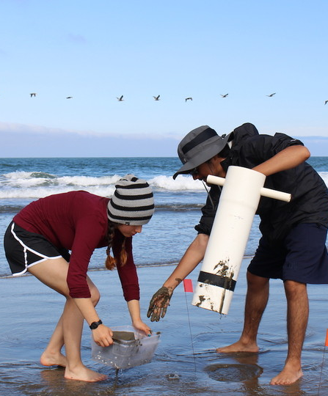
Moving on from just facts
When instruction focuses on facts…
Students don’t build the skills needed for real science
Students don’t relate to science or scientists
Students don’t understand where science comes from
Notes:
Often science has been taught as a vast collection of facts that students need to memorize. Facts are important, but facts alone do not help students. Unfortunately, science instruction has historically been very fact heavy. Why? Well, I am sure you are all thinking similar thoughts to yourselves right now, but in a word it is—TESTING. Standardized testing is not bad, but it has unfortunately often become a driving factor in instruction nationwide. This year, DEED will be field testing a new statewide summative science assessment that focuses less on facts and more on comprehension and processes.
0:45

Slide 17
Old Alaska GLEs for Science
Facts about science
Doing science
Notes:
The old GLEs for science were pretty heavy on memorization of facts, and unfortunately not much doing of science—which tends to disenfranchise many students.
0:30

Slide 18
Organization of the SSAs
Science and Engineering Practices
(doing science)
Disciplinary Core Ideas
(facts)
Crosscutting Concepts
(connecting science)
Notes:
Instead of focusing on just facts, the SSAs shifted to a more student-centered approach that engages students in doing science and targets comprehension of ideas. It mixes the action of science with content (facts) and creating connections between disciplinary topics and strands. Scientific inquiry is inherently cross-curricular, so the SSAs are laid out for science instruction to model this.
0:45

Slide 19
Active Learning
    Science is constructivist
      Experiential
      Students create own epistemology of the world within the bounds of evidence
    Benefits of active learning in science:
      Provide opportunity for and promotes higher order thinking
      Promotes interaction
      Increases retention
      Connects theory to application
      Builds proficiency and self-esteem
Notes:
Mastering science requires active learning!
Science is inherently constructivist. That is to say that students learn content via experience in real-world situations where they are able to contextualize information into personal epistemologies via metacognitive actions.
0:45

Slide 20
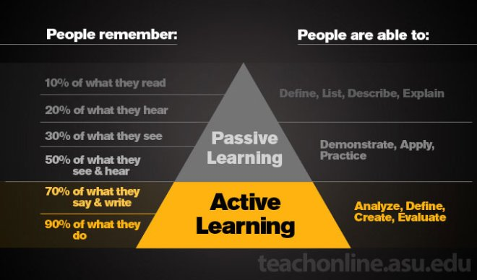
Active Learning Pyramid
Notes:
The SSAs are K-12 standards. The GLEs were 3-12 standards.
0:45

Slide 21

Brain Break!

Slide 22



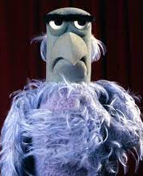

Evaluate
1 Perfect
2
Pretty Good
3
Average
4
Some Issues
5
HELP!
Notes:
ZOOM Poll
How are you feeling about science instruction in your district right now?
1:00

Slide 23
The Standards
Notes:
0:15

Slide 24
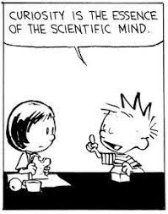
Goals of Science Education
Notes:
As we begin our discussion of Alaska’s new standards, it is important to keep in mind the two major goals of science education:
Scientific Literacy—Educating all students in science and engineering to become informed citizens and good consumers of scientific information.
Preparation for Careers—Providing the foundational knowledge for those who will become the scientists, engineers, technologists, and technicians of the future.
0:45

Slide 25
How to Read the SSAs
Notes:
0:15

Slide 26
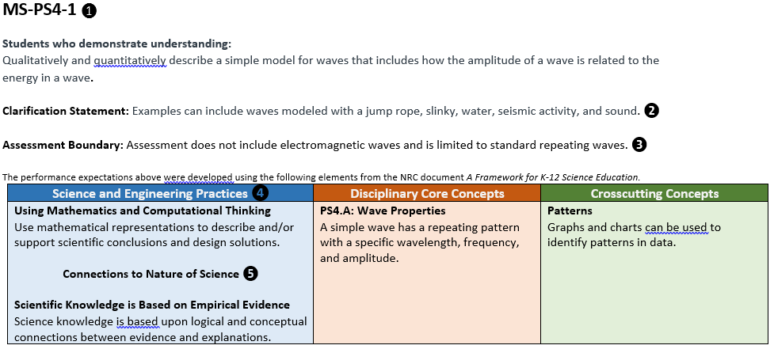
How to Read the Standards..
Notes:
This is a screenshot of a middle school performance expectation from the SSAs. If you are used to the old GLE document, this slide may look a little intimidating. It is true that the SSAs provide much more information and guidance than the GLEs ever did, but all of the information seen here is actionable and serves very intentional purposes.
We will break each section down and look at it more closely in the following slides. Note the five numbered elements in this slide. We will look at numbers 1-3 first…
0:30

Slide 27
How to Read the Standards.…
❶
MS-PS4-1
Students who demonstrate understanding: Qualitatively and quantitatively describe a simple model for waves that includes how the amplitude of a wave is related to the energy in a wave.
Clarification Statement: Examples can include waves modeled with a jump rope, slinky, water, seismic activity, and sound.
Assessment Boundary: Assessment does not include electromagnetic waves and is limited to standard repeating waves.
Performance Expectation
❷
❸
Notes:
❶ Performance Expectation (PE) Code. The first part of the code indicates the grade level or span (e.g. MS = Middle School). The second part identifies the subject area (e.g. PS = Physical Science). The last part identifies the specific standard (e.g. 4-1). The Performance Expectations are primarily what a student should understand at the end of instruction. They are not instructional strategies or outlines, nor are they stated objectives for the lesson. They summarize the knowledge the teacher should be assessing at grade level.
❷ Clarification Statements provide additional clarification to the Performance Expectation and will often include examples of how the PE may be operationalized. The Clarification Statement may also provide explanation on where to focus of the student’s instruction. Not every PE will have a clarification statement.
❸ Assessment Boundaries clarify limits to large-scale assessments—in other words, the state exam. It outlines the expected limitations on the content, or in other words, what the student is expected to know at this grade level. Local assessment can and should probe deeper for students’ comprehension of the PE. Not every PE will have an assessment boundary.
1:15

Slide 28
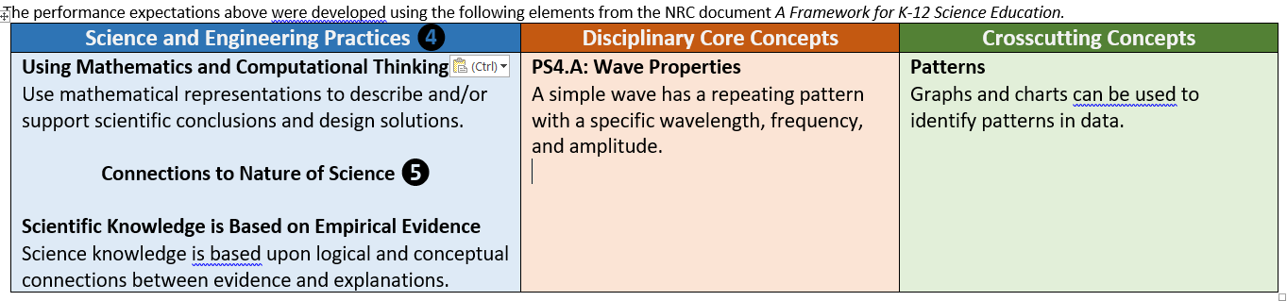
How to Read the Standards…
Foundational boxes
Notes:
❹ Foundational Boxes. Below the Performance Expectations, you’ll see three different colored boxes of text. These are the Foundation Boxes and are organized around the SSAs three dimensions. Under each box are the skills and content necessary to reach an understanding of the topic, as outlined by the Performance Expectations. Each competence and knowledge base references the Performance Expectation it helps the student reach. The boxes show how to use the SSAs to teach the PE.
❺ Connecting concepts can be found in either the practices or crosscutting concepts foundation boxes. They provide links to other scientific concepts or ideas to emphasize that science is interconnected.
0:45

Slide 29
Major Shifts in the SSAs
Notes:
0:15

Slide 30


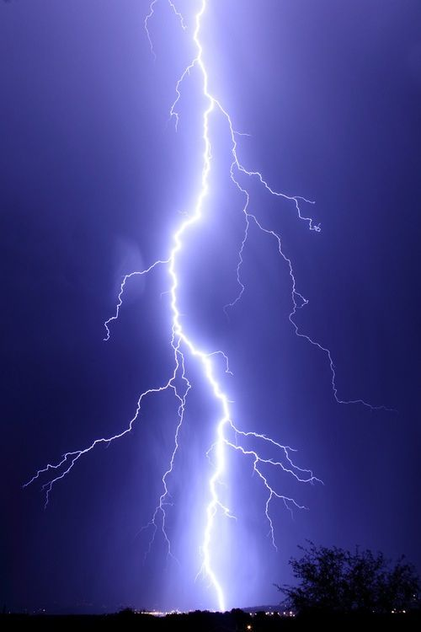


Five Major Shifts
Notes:
There are five major shifts in instruction from the GLEs to the SSAs -
Incorporation of Three-Dimensional Learning mentioned earlier.
Students engage with science through the lens of Phenomena and Designed Solutions
That Engineering and the Nature of Science are integrated into and across the SSAs
All three dimensions build coherent learning progressions
That science is connected to math and literacy
0:45

Slide 31
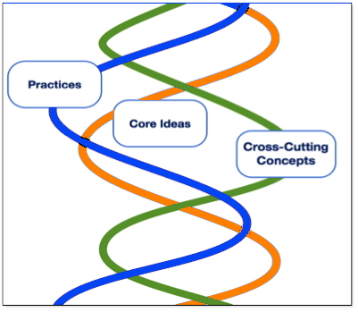
Three-Dimensional Learning
Notes:
Let’s look a little more closely at the idea of Three-Dimensional Learning. The SSAs are organized into three overlapping principles, which represent a three-dimensional system of learning. The standards themselves are organized around these dimensions and represent a shift in traditional science education. It’s critical to understand the three dimensions to read the SSAs. They are:
Disciplinary Core Ideas
Cross-Cutting Concepts
Scientific and Engineering Practices
The next three slides will look at each sub-category in a bit more detail.
0:45

Slide 32
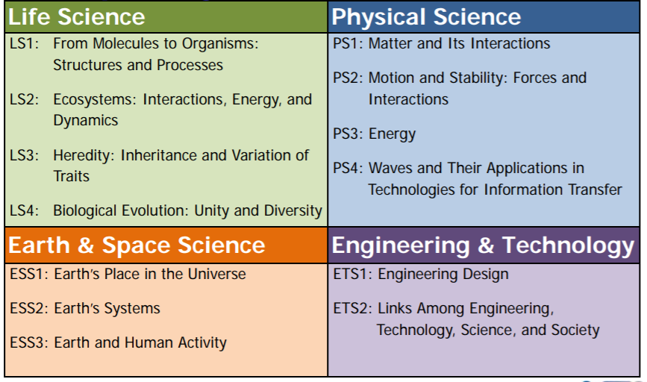
Disciplinary Core Ideas
Notes:
Disciplinary core ideas are the big ideas of science that provide scientists and engineers with the concepts and foundations to make sense of phenomena or design solutions to problems
You will note that the DCIs very closely mirror traditional content areas in science. The notable exception being the addition of “Engineering & Technology” as a fourth pillar. This is very intentional since it is disingenuous to leave out the impact and importance of engineering and technology on modern science.
Now, if you are like me and have watched far more Big Bang Theory in your life than is good for you, you will be aware that there is historically a certain tension between engineers and scientists. They may not always see eye-to-eye, but neither discipline could exist without the other.
0:45

Slide 33
Crosscutting Concepts
Patterns
Cause and effect: Mechanisms and explanation
Scale, proportion, and quantity
Systems and system models
Energy and matter: Flows, cycles, and conservation
Structure and function
Stability and change
Notes:
Crosscutting concepts are themes that have application across all disciplines of science. As such, they provide a way of linking the different subject areas.
These seven core concepts are ideas that should be explicitly taught to students.
Lower elementary teachers will need to identify these for their students, creating activities that support and guide students through the concept.
In later grades, teachers should work with students to identify the concepts associated with the PE and have them make their own connections to other areas in science where the concept arises.
0:45

Slide 34
Science and Engineering Practices (SEPs)
Asking questions (for science) and defining problems (for engineering)
Developing and using models
Planning and carrying out investigations
Analyzing and interpreting data
Using mathematics and computational thinking
Constructing explanations (for science) and designing solutions (for engineering)
Engaging in argument from evidence
Obtaining, evaluating, and communicating information.
Notes:
Science and Engineering Practices are the behaviors that:
Scientists engage in as they investigate and build models and theories about the natural world, and
That engineers use as they design and build models and systems.
As you look this list over, you may note that the SEPs closely align to pedagogical practices—many of which you may already utilize in your classroom. The new standards formalize these as expectations for all students. You may also see parallels between the SEPs and the Alaska English/Language Arts and Mathematics Standards. This is intentional. The SEPs are critical thinking skills that transcend topic areas. Every student graduating high school in Alaska should be able to engage in these activities.
0:45

Slide 35
Learning Strategies
Notes:
0:15

Slide 36
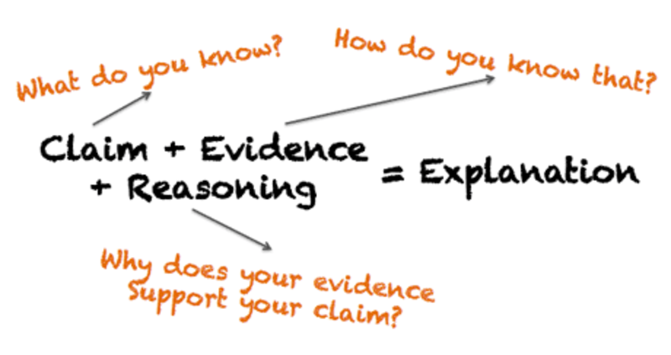
Engaging in Arguments Using Evidence
Notes:
Discourse with peers challenges students to think through their reasoning for a claim or idea. Students learn to analyze the data they produce, determine if generalities can be drawn from it, then construct an argument using that evidence. The arguments will be subject to peer review and students will be called upon to defend the basis of their claim in detail. Arguing is not conflict; it is explaining through logical reasoning associated with real results.
Argumentation from evidence helps to build a scientifically literate population. This ability is critical to every student—regardless of whether they intend to become a professional scientist or not. It builds the skill set necessary for students to be able to critically and analytically assess the validity of evidence and arguments to make informed and independent decisions.
1:00

Slide 37
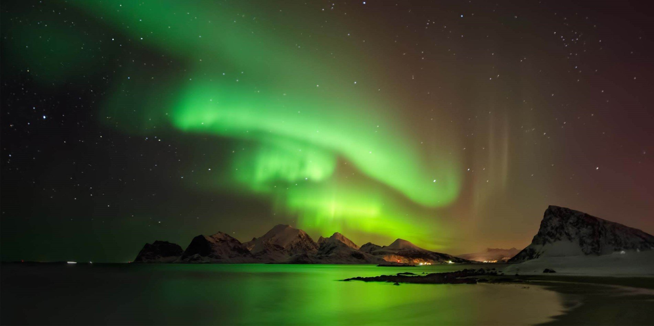
Argumentation
Notes:
BREAKOUT ROOMS = 5 MINUTES + 60s
Claim + Evidence + Reasoning = Explanation
Make a claim, provide evidence, support with reason

Slide 38
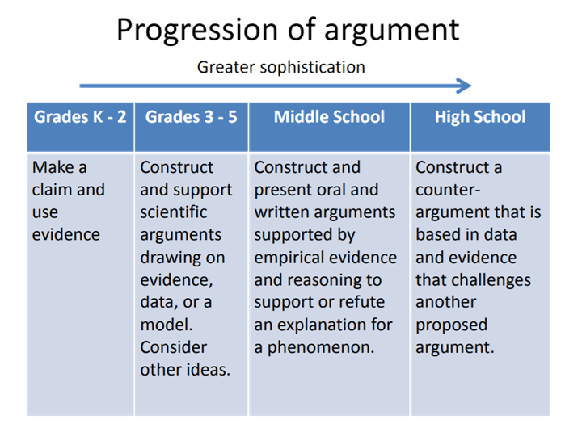
Argumentation Progression
Notes:
ZOOM POLL
What do you think is the best reason for students to engage in argumentation?
To have students defend their ideas.
To help students make sense of the world.
To support students in using evidence.
To engage in doing science.
All of the above.

Slide 39
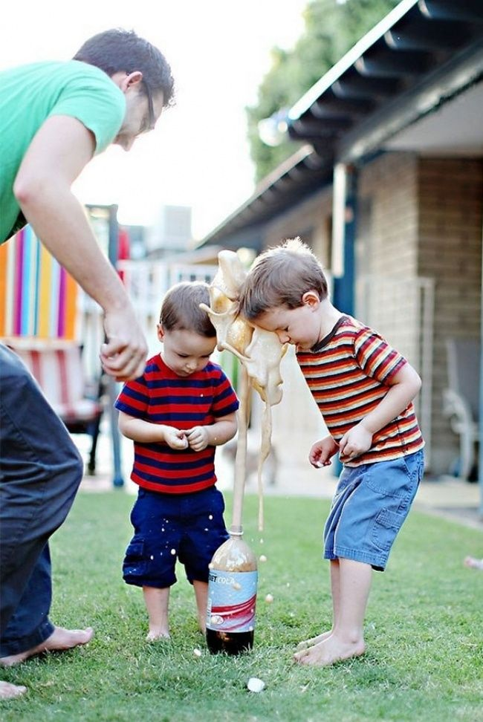
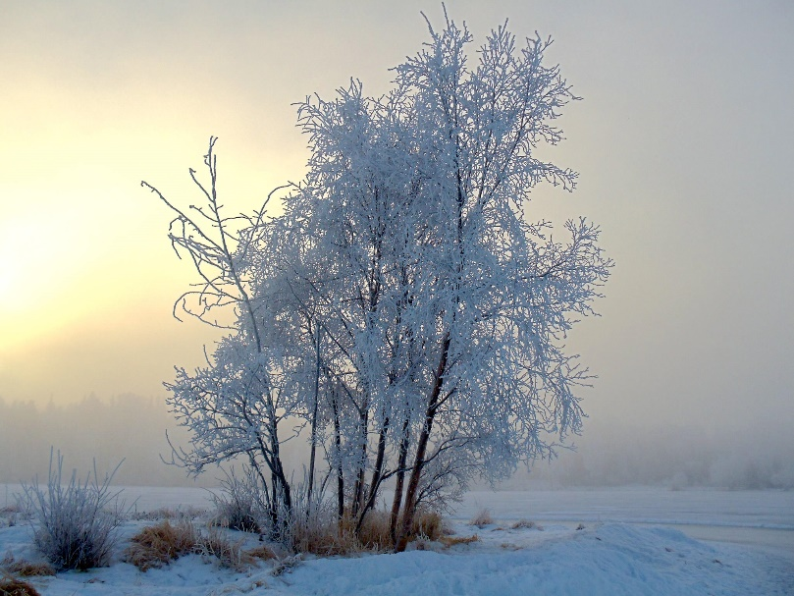
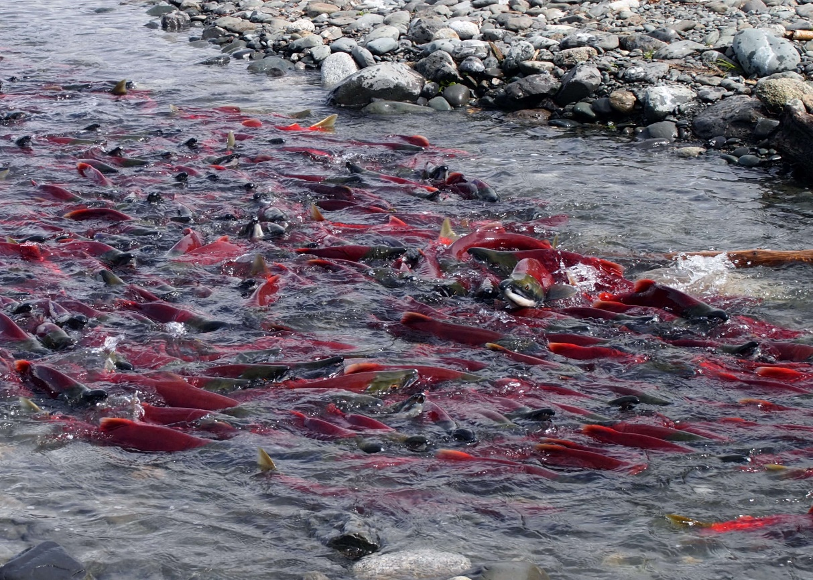
Phenomena
Notes:
Phenomena are a way to hook students’ interest and contextualize science learning, and they are central to the new standards. Phenomena are real-world examples of science in action that engage students in complex problems. These can be quite varied as shown in the pictures here. Traditional experiments like dropping mentos into diet soda are direct methods of demonstrating natural phenomena. Other phenomena are more subtle, such as how and why hoar frost forms on trees, or how do salmon find their way back to spawn?
Some guiding questions to consider when choosing a phenomenon are:
Does the phenomenon occur in the student's’ local environment, is the phenomenon anchored in real-world issues, or does the phenomenon relate to a problem that needs to be solved?
Can students observe and/or investigate the phenomenon either through firsthand experiences (e.g., directly in a classroom, lab, or outdoor environment) or through someone else’s experiences (e.g., through video presentations, research, or analyzing patterns in data)?
Do students have to connect Core Ideas and Crosscutting Concepts through Science and Engineering Practices to explain how and why the phenomenon occurs?
By making sense of the phenomenon, do student explanations build grade-level understanding towards performance expectations?
Will students find making sense of the phenomenon interesting and important?
Does the potential student learning related to the phenomenon justify the financial costs and classroom time that will be used?
Are the phenomenon analogous to other phenomenon to build an instructional sequence or extend the learning?
Once you have a phenomenon you are considering for a lesson or sequence of lessons, unwrap the phenomenon to discover how the crosscutting concepts can be used to connect the disciplinary core ideas to explain the phenomenon. The next step is to align the phenomenon to the standards based on grade level appropriateness.
1:30

Slide 40

Phenomena Breath
Why can I see my breath when it is cold outside?
Notes:
Seeing your breath on a cold day is a science phenomena that students can relate to. You could engage students in making sense of this phenomenon by having them....
Ask Questions: How does the breath change the appearance of the air? Where did the fog-like vapor come from? Why does it not appear on hot days? Where else does this phenomena happen? Would any warm air make fog? Is this why a mirror fogs when I breath on it?
Develop data using investigations (e.g., observe breath at various temperatures, breathe into a bag and then release air into a refrigerator, breathe on a cold water bottle on a warm day, release cold air on a hot day.)
Develop relationships between crosscutting concepts and core ideas to construct explanations through models supported by evidence (e.g., heat energy transfers from high to low, matter is conserved, matter changes state, water appears as droplets in the cold air, organisms give off water vapor.)
Communicate explanations using models and arguments to make their thinking visible.
1:30
ACTIVITY: Go to Menti.com and identify some local examples of phenomena you can use with your students.

Slide 41
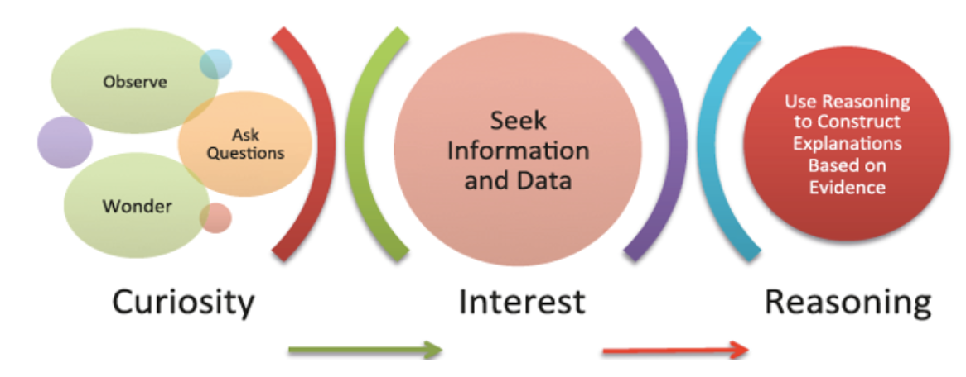
Developing and Using Models
Notes:
Models help students with scientific thinking and processing, not just memorization. They help students contextualize and make sense of scientific information, engage their inquisitiveness, and motivate them to understand the “why” not just the “what”. Models are helpful tools in representing ideas and explanations that allow for multiple ways of understanding.
0:30

Slide 42
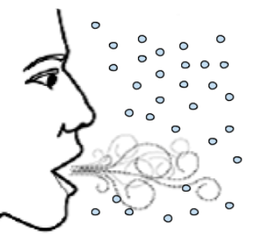
Modelling a Phenomenon
Cold environmental air
Condensing water molecules
Warm air and water vapor
from lungs
Notes:
Returning to our previous phenomenon of seeing one’s breathe a cold day, this diagram beings to explain the why.
Models are used in both science and engineering as tools for understanding. The wide range of models used in science and engineering includes, but is not limited to, conceptual models such as drawings and diagrams, maps, three-dimensional structures, physical scale models, mathematical formulas, analogies, computer simulations, and mental models.
0:45
ACTIVITY: Go to Menti.com and identify some ways you might incorporate modelling with your students.

Slide 43

Pedagogical Changes
Notes:
The grade-span specific webinars will dive into much deeper detail on pedagogy, but for the moment I would like to get your thoughts on what types of pedagogical changes you see in the SSAs. We are going to use Jamboard to record your responses, so please take a minute to click on the hyperlink entered in the chat box and record your thoughts.
1:00
JAMBOARD
https://jamboard.google.com/d/1fBkX59L-flx3XwreXnCiNPUq0pTof_QQj0jjDCURIjI/edit?usp=sharing

Slide 44


Cross-curricular Connections
Notes:
Finally, I want to take just a few moments to emphasize the cross-curricular nature of the Science Standards for Alaska. These standards have very intentionally been aligned to both the ELA and Math standards to allow easy incorporation of all three standard sets at every grade level.
Scientific inquiry requires other content areas. It is inherently interdisciplinary. It requires the application of mathematics, literacy skills, technology, civics, ethics, and even art. Science does not exist in a vacuum. It is the result of combining numerous disciplinary areas in novel ways. Take for example this photo of the Dragon Crew Capsule launch. Launching a human into space obviously requires a mastery of mathematics, physics, chemistry, and biology. But it also requires proficiency in literacy—to read manuals and launch procedures, and to communicate with the public. It requires the will of the people and a commitment from the government. It requires a firm grasp and application of the newest technologies. It raises ethical questions about the utilization of, and access to, space. And yes, it definitely incorporates elements of art and design – would anyone deny this photograph is a work of art?
0:45

Slide 45
Resources
Notes:
0:15

Slide 46
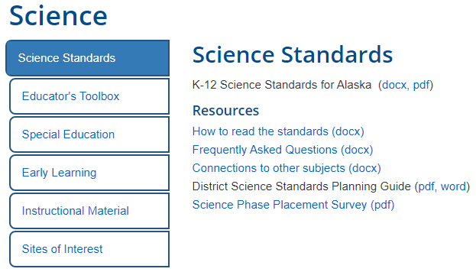
Science Standards Webpage
https://education.alaska.gov/standards/science
Notes:
0:45

Slide 47
Key Resources
Science Standards for Alaska (SSA) to Alaska ELA/Math Standards Connections
Alaska Science GLEs to Science Standards for Alaska Crosswalk
Teacher Primer for the Science Standards for Alaska
Notes:
1:00
This meeting has been recorded and DEED will post the video soon. Look for a link from the DEED standards webpage.

Slide 48





Where to Look for Lesson Plans
Notes:
0:30
https://ngss.nsta.org/Classroom-Resources.aspx
https://www.nextgenscience.org/resources/examples-quality-ngss-design
https://www.adfg.alaska.gov/index.cfm?adfg=educators.main
https://www.fishwildlife.org/projectwild
https://www.adfg.alaska.gov/index.cfm?adfg=educators.wildwonders
https://www.projectwet.org/

Slide 49
Upcoming Webinars
Grade-span Specific Deep Dives
Notes:
0:15

Slide 50
Grade-span Webinars
3 Feb. 2021
Lower Elementary (K-2)
5 Feb. 2021
Middle School (6-8)
10 Feb. 2021
Upper Elementary (3-5)
12 Feb. 2021
High School (9-12)
Notes:
1:00
Registration link into chat box…
https://app.smartsheet.com/b/form/b606d757faa74599b0f10a106ae4845a

Slide 51
Alaska Science Teachers’ Listserv
Notes:
http://list.state.ak.us/mailman/listinfo/ak.scienceteachers
1:00

Slide 52

Contact Information
Dr. Bjørn Wolter
Program Manager
bjorn.wolter@alaska.gov
907-465-6542

Slide 53

Questions?

